Slide 1

Human Information Processing –Task Modeling and Human Problem Solving model
Tools and Methods based on Task Models

Slide 2
Models of Information Processing
Atkinson & Shiffrin’s multistore model
  Three parts of system
    Sensory register
    Short term memory (STM) (book = short term store)
    Long term memory (LTM) (book = long term store)
  Inborn and universal
  Analogy = computer
    Stores = hardware
    Control processes/mental strategies = software

Slide 3
Atkinson & Shiffrin’s Model
Sensory Register
  Sights/sounds represented directly
  Limited capacity
Short-Term Memory (STM)
  Conscious part
  Limited capacity
    7 +/- 2 units of information
  Limited time

Slide 4
Atkinson & Shiffrin’s Model
Long-Term Memory (LTM)
  Unlimited capacity
  Unlimited time frame
  Organization and memory strategies

Slide 5

Information-processing Model of Human Problem Solving
• Types of Knowledge that might be in a chunk of information:
– General knowledge
• Information that most people know and apply without regard to a specific
domain
– “red is a color.” “4 is bigger than 3.”
• Gained through everyday experiences and basic schooling
– Domain Specific Knowledge:
• Information on the form or function of an individual object or a class of objects
– Bolts are used to carry shear or axial stress
– The proof stress of a grade 5 bolt is 85 kpsi.
• Gained from study and experience in the specific domain
– It may take about 10 years to gain enough specific knowledge to be considered an
expert in a domain
– Procedural Knowledge:
• The knowledge of what to do next
– If there is no answer to problem X, then decompose X into two independent
subproblems of x1 and x2 that are easier to solve.
• Gained mostly from experience
• Required for solving mechanical design problems

Slide 6
Information-processing Model of Human Problem Solving
• Short-Term Memory (STM):
– Corresponding to RAM in a computer
– Main information processor in the human brain
– Information chunks can be processed in about 0.1 sec.
• Processing implies such actions as comparing one chunk of information to another, modifying a chunk
(decomposing or assembling), etc.
– The more memory is used to solve harder problems.
– “Magical Number Seven, Plus or Minus Two” Capacity of the short-term memory
• Only two or three chunks can be compared at one time due to limits in short-term memory capacity.
• Long-Term Memory (LTM):
– Permanent retention of information (Disk storage in a computer)
– Unlimited capacity
• No documented case of anybody’ s brain becoming full regardless of the head size
– Fairly slow in recording information (2-5 minutes to memorize a single chunk of info)
– Speedy recovery of information, although retrieval time depends on the complexity of the information and the
recentness of its use.
– Information can be retrieved at different levels of abstraction, in different languages, and with different features.
• Human memory is powerful in matching the form of the data retrieved to that which is needed for processing
in the short-term memory.
• Control of the Information Processing System:
– enables us to encode outside information obtained through our senses or retrieve information from LTM for
processing in STM.
– When completed manipulating the info, the controller can store the results in the LTM or in the external
environment by describing it in text, verbally, or in graphic im ages.

Slide 7
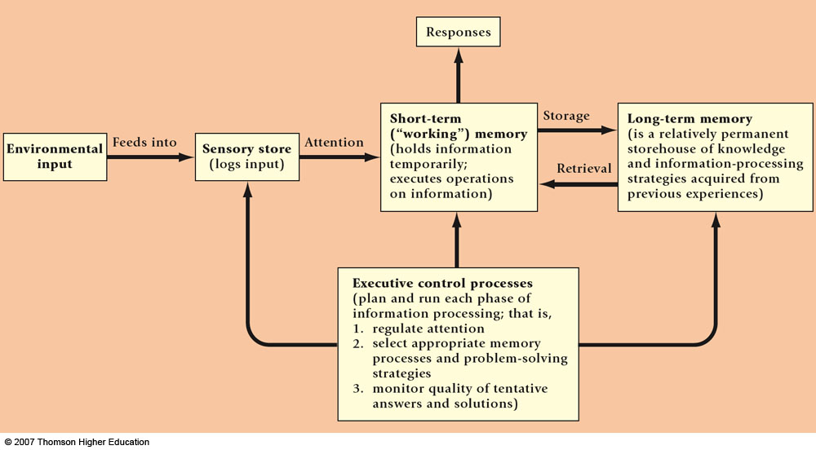
A schematic model of the human information processing system. ADAPTED FROM ATKINSON & SHIFFRIN, 1968.

Slide 8
human problem-solving or information-processing efforts consist of these important parts:
      Sensation, which senses external information (e.g., visual, aural, haptic), and Perception, which interprets and extracts basic meanings of the external information.
      Memory, which stores momentary and short-term information or long-term knowledge. This knowledge includes information about the external world, procedures, rules, relations, schemas, candidates of actions to apply, the current objective (e.g., accomplishing the interactive task success- fully), the plan of action, etc.
      Decision maker/executor, which formulates and revises a “plan,”
then decides what to do based on the various knowledge in the memory, and finally acts it out by commanding the motor system (e.g., to click the mouse left button).

Slide 9
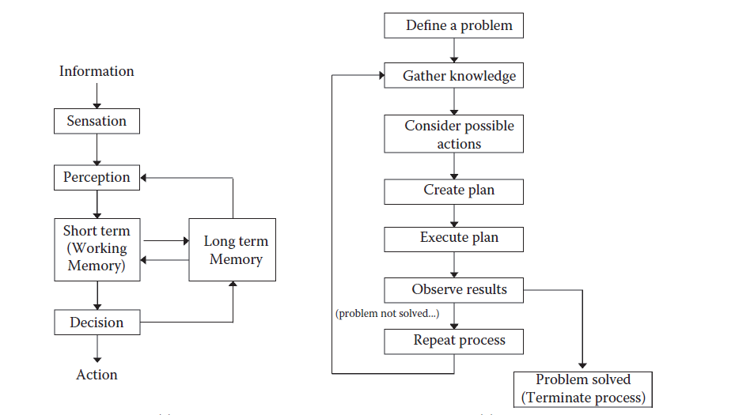
(a) The overall human problem-solving model and process and (b) a more detailed view of the “decision maker/executor.”

Slide 10

Why Model-based approaches?
Highlight important information
Help to manage complexity
Useful to support methods
Tools and Methods based on Task Models

Slide 11

Models
 What are the properties of a model?
 A model should
Focus on one particular aspect of the real world
(here, the UI, the Interactive Application) to be
represented and emphasized
Raise the abstraction level by promoting appropriate
abstractions of the real world (multiple and ample
possibilities)
Be declarative, rather than procedural
Tools and Methods based on Task Models

Slide 12
Model-Based Interface Design and
Development
Goals:
To provide comprehensive development
environments (i.e., design and implementation
phases)
To improve usability and portability of interfaces
To integrate usability analysis with interface
development
To promote declarative UI knowledge (rather
than imperative, procedural)
Tools and Methods based on Task Models

Slide 13

How can we reach them?
 By using a new paradigm: model-based interface
development involving 3 facets:
Models: explicitly capture knowledge about UI and
Interactive Applications with appropriate abstractions
Methods: structure the definition and use of
underlying models and related transformations
Supporting tools: support the use of the method by
providing tools for models and their related
transformations.
Tools and Methods based on Task Models

Slide 14
Significant Models in HCI
Task models
Cognitive architectures
User models
Domain Models
Context Models
Presentation Models
Dialogue models
Tools and Methods based on Task Models

Slide 15
Definitions
Task – activity that has to be performed to reach a
goal
Goal
desired modification of state
Attempt to receive state information
Each task is associated with one goal
Each goal is associated with one or multiple tasks
Multiple abstraction levels - Basic task
Task Analysis
Task Models
Tools and Methods based on Task Models

Slide 16
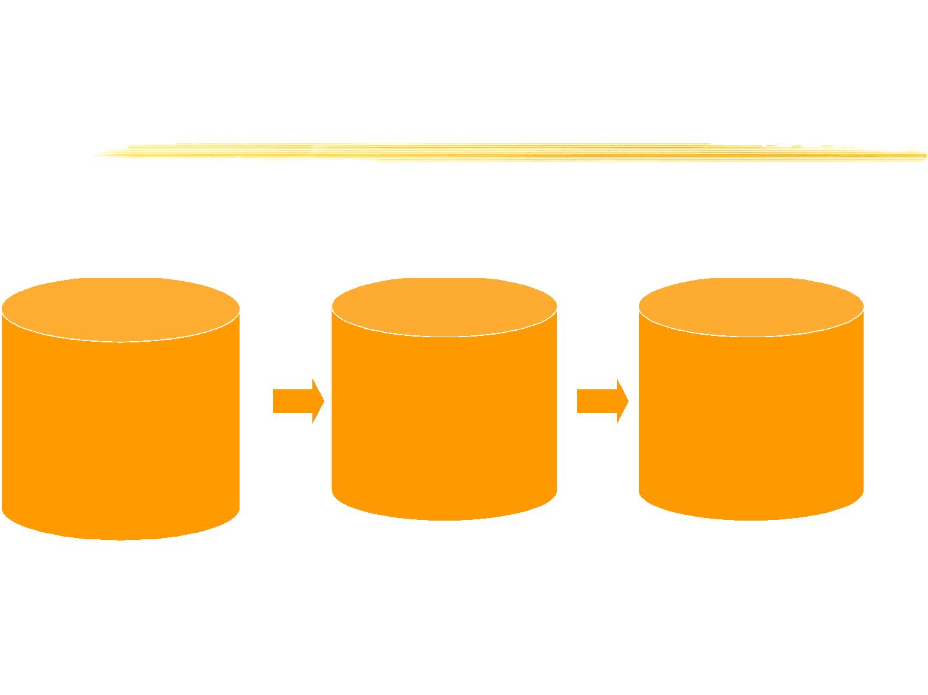
Moving from informal to
structured representations
Inf ormal Analysis
Structured Analysis
Abstractions
Interviews
Questionnaires
Requirements identification
Scenarios
Domain models
Task models
User and System Models
Existing documentation
Activity analysis
Current training
Use cases
Dialogue models
Properties
Task analysis
Tools and Methods based on Task Models

Slide 17
Scenarios
Informal,compact description of:
one (or multiple) specific user
Who interacts with a specific interface
To reach a specific goal
In a specific environment
Tools and Methods based on Task Models

Slide 18
Example of scenario
Silvia is looking for interesting papers on patterns. She makes a
request to the on-line library by giving the name of the topic as
one of the parameters of her request, and indicating that she is
interested in papers written in English. The order of providing
these two parameters is not important. She receives a long list
of references. As she is interested in recent contributions she
adds a further constraint in the request so that she receives
information only on papers published in the last five years. The
new list of publications is more manageable. She understands
that the works by Gamma are very relevant. She would like to
have them grouped so that they are presented together. Thus
she makes a new request adding the constraint that the author
has to be Gamma. The result is the information that she was
looking for. Now she can move to another request for another
topic.
Tools and Methods based on Task Models

Slide 19
Use of Scenarios
Capture the context where the application is
used
Elicit requirements
Identify important episodes from the user
behaviour
To provide a context for performing
evaluation
Ability to highlight issues and stimulate
discussion while requiring limited effort to
develop
Tools and Methods based on Task Models

Slide 20
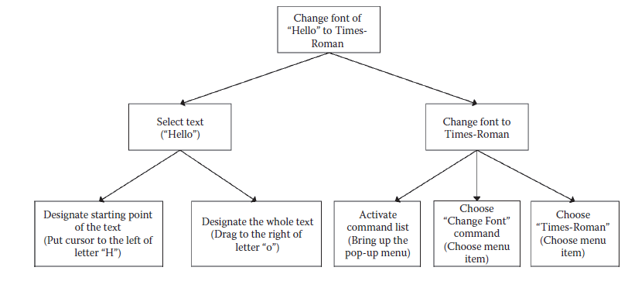
example of a hierarchical task plan
for performing
evaluation

Slide 21
Task analysis
Example: Task analysis of tourists visiting a virtual museum application
 Tourists are characterised by a low average knowledge of the topics
considered. Usually they prefer to have guided tours through the rooms of
the museum and the town with pictures and information about the works of
art. However linear pre-defined tours alone would be too restrictive so some
degree of navigational freedom is important. Access to the information is
provided with the support of spatial representations: the museum and town
maps. This allows users to have immediate information about the locations
of the works.
 Tourists want general information on the artistic works, and this information
has to be presented clearly and in a limited amount because it has to be
interpreted easily. Thus a work will be presented by an image, the title, a
short description, the name of the author, the material and technique used
for its creation, and when it was made. Additional information about the
museum and the town can be provided on request, such as the path to get
to the museum from the closest railway station or airport, information (title,
data, location) on further exhibitions, and historical information on the town
and the museum.
Tools and Methods based on Task Models

Slide 22
Task analysis
general hierarchical task model, certain subtasks need to be applied in series
task model can be hierar- chically refined and can serve as a basis for the interface structure.
Note that, based on this model, we could “select” interfaces to realize each subtask in the bottom of the hierarchy, which illustrates the crux of the HCI design process.
The interaction model must represent as much as possible what the user has in mind, especially what the user expects must be done (the mental model) in order to accomplish the overall task. This way, the user will be “in tune” with the resulting interactive application.
The interface selection should be done based on ergonomics, user preference, and other requirements or constraints.
Finally, the subtask structure can lend itself to the menu structure, and the actions and objects to which the actions apply can serve as the basis for an object-class diagram (for an object-oriented interactive software implementation).

Slide 23
Task analysis
Example: Task analysis of tourists visiting a virtual museum application
 Tourists are characterised by a low average knowledge of the topics
considered. Usually they prefer to have guided tours through the rooms of
the museum and the town with pictures and information about the works of
art. However linear pre-defined tours alone would be too restrictive so some
degree of navigational freedom is important. Access to the information is
provided with the support of spatial representations: the museum and town
maps. This allows users to have immediate information about the locations
of the works.
 Tourists want general information on the artistic works, and this information
has to be presented clearly and in a limited amount because it has to be
interpreted easily. Thus a work will be presented by an image, the title, a
short description, the name of the author, the material and technique used
for its creation, and when it was made. Additional information about the
museum and the town can be provided on request, such as the path to get
to the museum from the closest railway station or airport, information (title,
data, location) on further exhibitions, and historical information on the town
and the museum.
Tools and Methods based on Task Models

Slide 24
Task Analysis (task list)
 Access to guided tours through the museum and the town
 System enable some degree of navigational freedom
 Access to the information through spatial representations.
 Access to general information on the artistic works
 System presents information clearly and in a limited amount
 System presents a work by an image, the title, a short
description, the name of the author, the material and technique
used for its creation, and when it was made.
 Additional information about the museum and the town can be
provided on request.
Tools and Methods based on Task Models

Slide 25
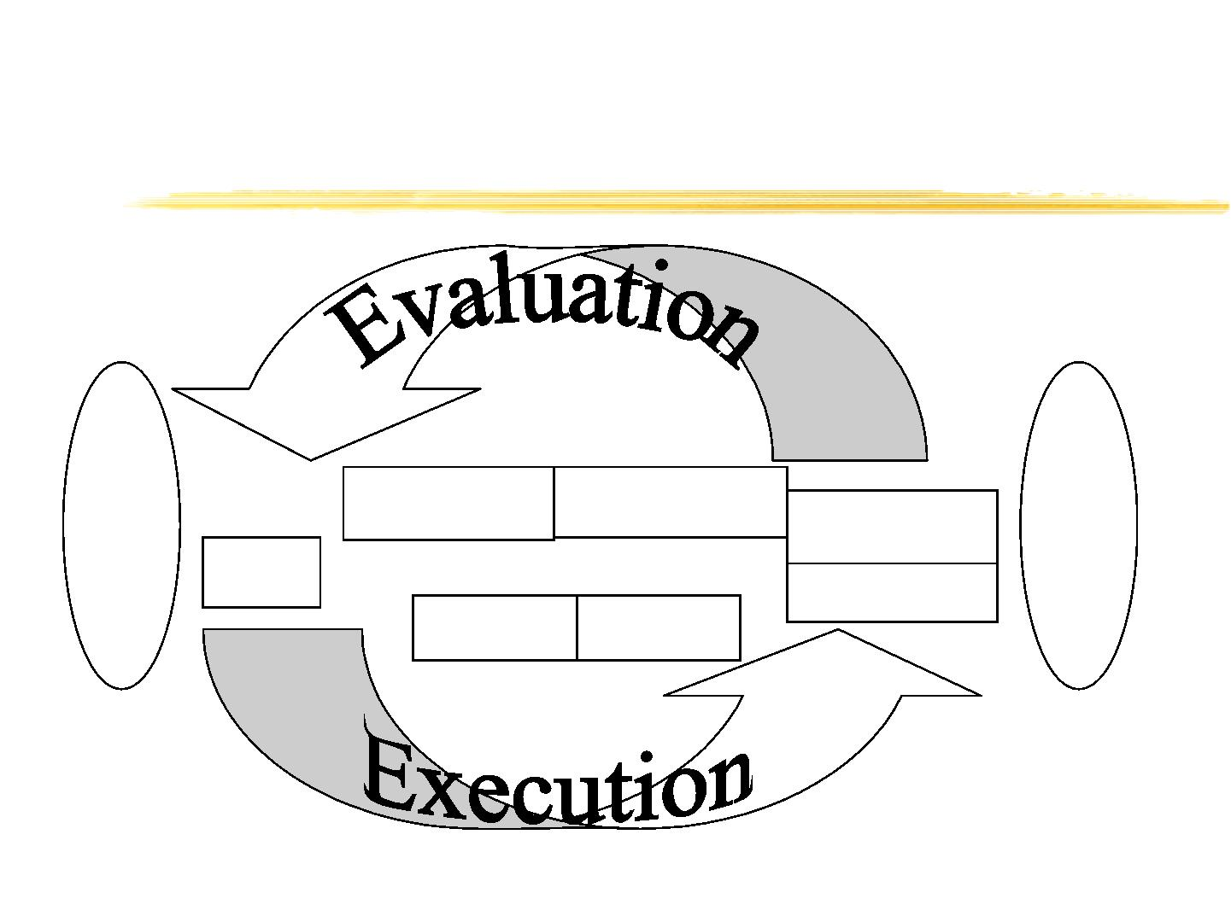
Norman’s cycle of interaction
S
Y
S
T
E
M
U
S
E
R
Evaluation
Interpretation
Perception
Execution
Goal
Intention Action
Tools and Methods based on Task Models

Slide 26
Detectable problems
Lack of correspondence between user
intentions and actions supported by the
interface
Lack of correspondence between
representations provided by the system
and those expected by the user
The best interface is that invisible that
does not provide obstacles when users
perform their tasks
Tools and Methods based on Task Models

Slide 27
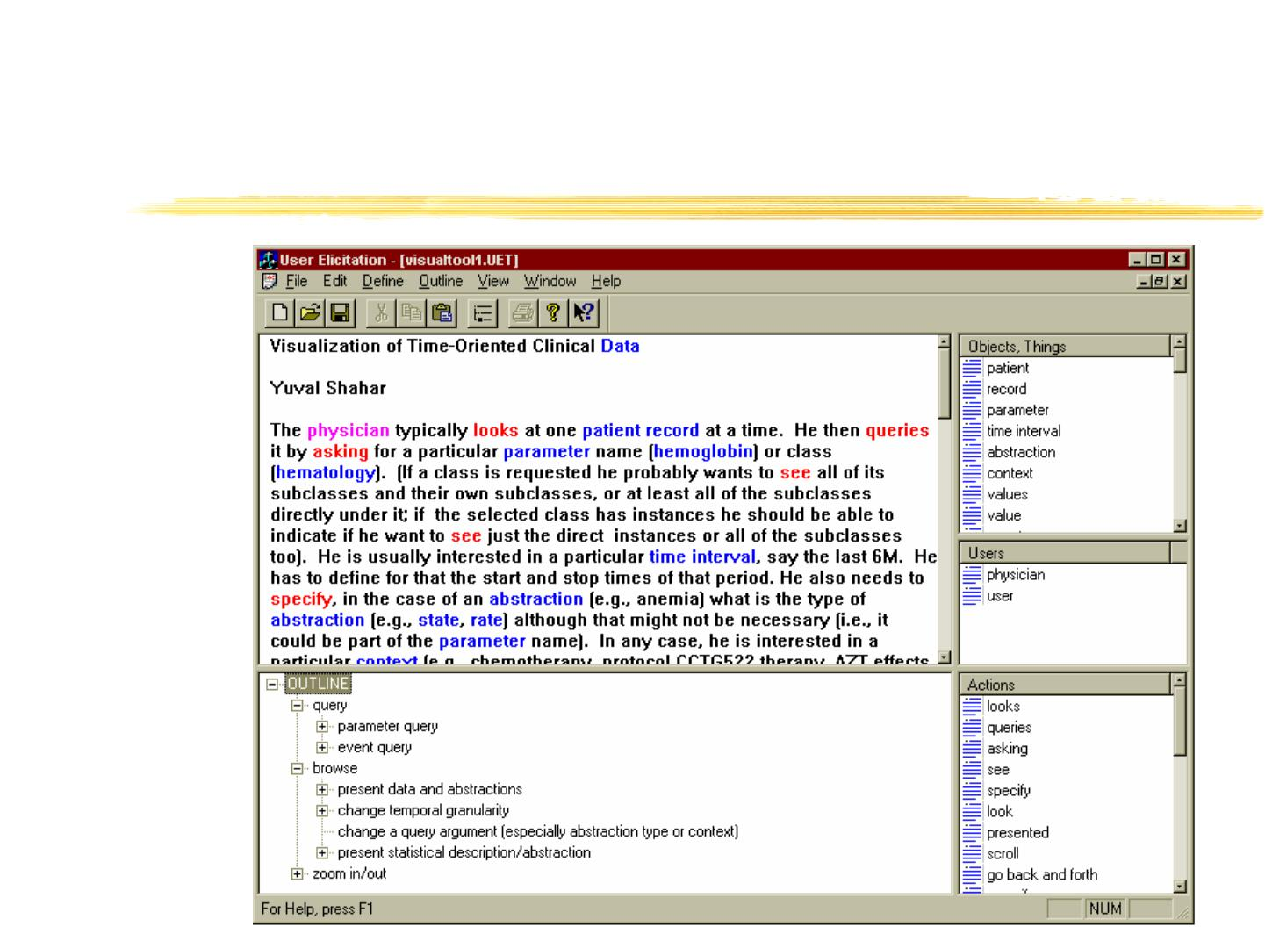
User-Elicitation Example for
a Medical-Domain Interface
Tools and Methods based on Task Models

Slide 28
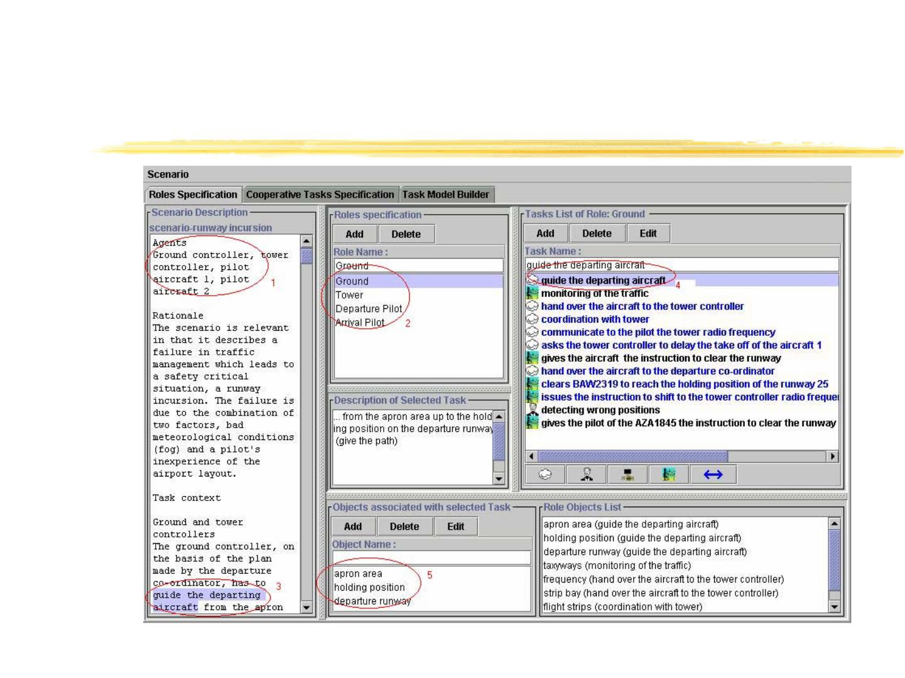
The environment supporting
task identification
Tools and Methods based on Task Models

Slide 29
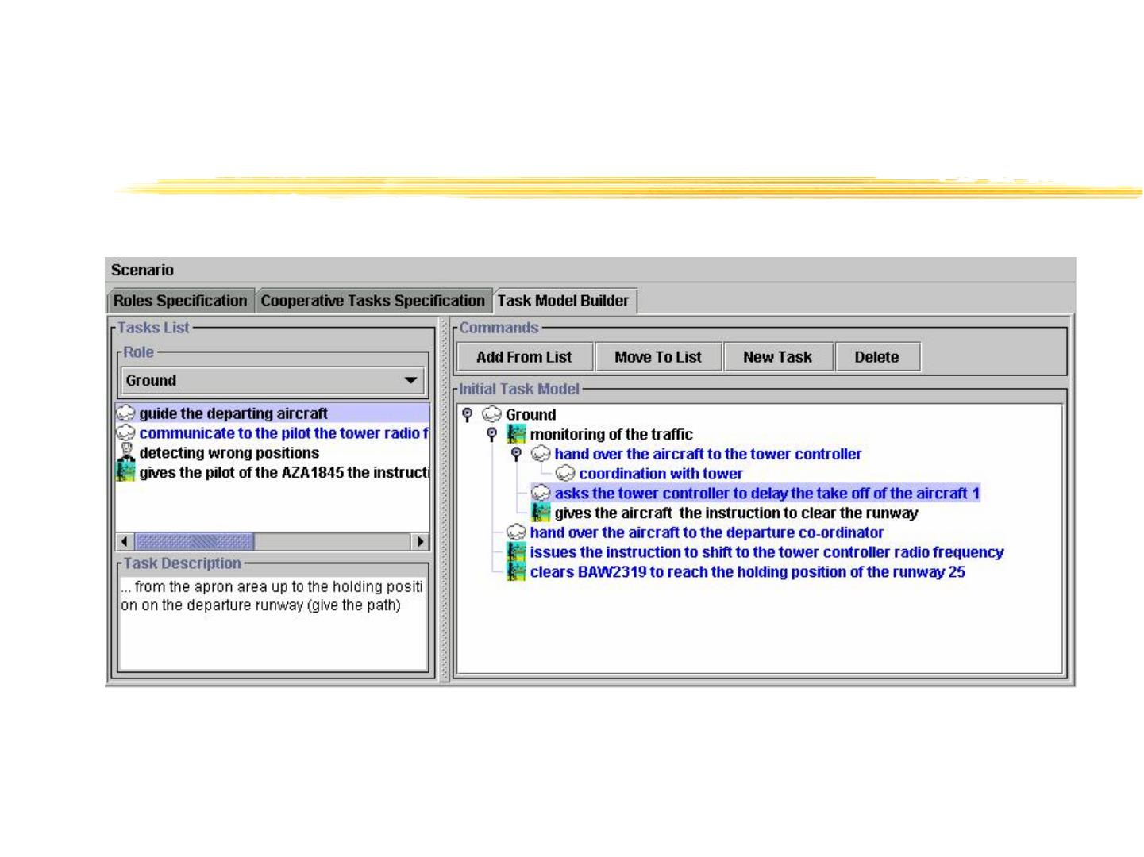
Tool support to structure the
task model
Tools and Methods based on Task Models

Slide 30
Engineering task models
Flexible and expressive notations with
precise semantics
Systematic methods able to indicate how
to use information in the task models
Availability of automatic tools to use
such information efficiently
Tools and Methods based on Task Models

Slide 31
Advantages of Task-based
approaches
For the designer: high-level, structured
approaches which allow integration of
both functional and interactional aspects
For the end user: support the generation
of more understandable systems
Tools and Methods based on Task Models

Slide 32
The many possible task models
(Describe) Existing System
(Define) Envisioned System
User
Tools and Methods based on Task Models

Slide 33
Use of Task Models
Improve understanding of the
application domain
Record the result of interdisciplinary
discussion
Support effective design
Support usability evaluation
Support the user during a session
Documentation
Tools and Methods based on Task Models

Slide 34
Task Models vs Scenarios
Scenarios are informal descriptions of a specific
use in a specific context
Task models describe the main possible activities
and their relationships
Scenarios can support task model development
Task models can support scenarios identification
Tools and Methods based on Task Models

Slide 35
Representations of Task Models
Hierarchical task analysis
GOMS family
UAN
Different syntax (textual vs graphical)
Different level of formality
Different set of operators for task
composition
Tools and Methods based on Task Models

Slide 36
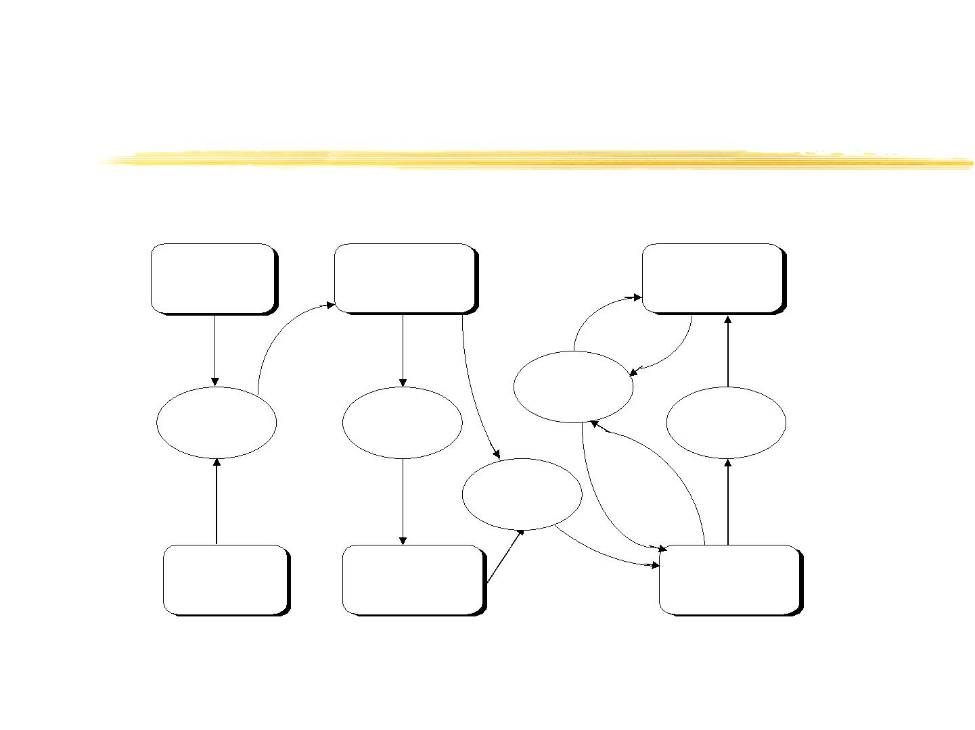
Use of Models in the Life Cycle
Requirements of
The New System
Envisioned System's
Task Model
Current Prototype's
Task Model
Evaluation
Task Modelling
Design
Reverse
Modelling
Design And
Software
Development
Existing System's
Task Model
Early System's
Prototype
Engineered
Prototype
Tools and Methods based on Task Models

Slide 37
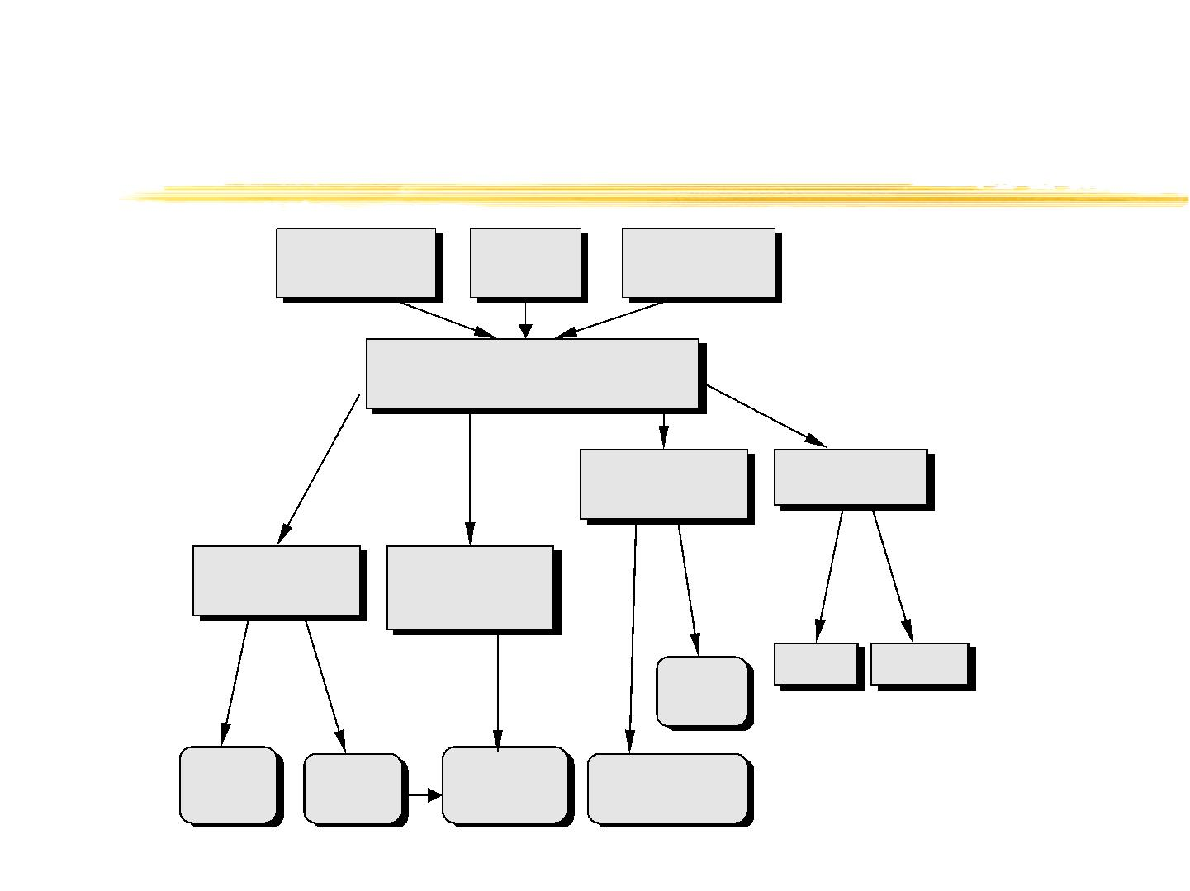
Approaches to task models
Cognitive
Science
Computer
Science
HCI
TASK MODELS
Descriptive
Models
Design Methods
Models for Task
Analysis
Models for
Performance
Evaluation
TLIM
MOBI-D
UAN
TKS
MAD
GTA
CPM-GOMS
KLM
GOMS
ConcurTaskTrees
Tools and Methods based on Task Models

Slide 38
Representations of Task Models
Hierarchical task analysis
GOMS family
UAN
Different syntax (textual vs graphical)
Different level of formality
Different set of operators for task
composition
Tools and Methods based on Task Models

Slide 39

GOMS Example
GOAL: EDIT-MANUSCRIPT
GOAL: EDIT-UNIT-Task repeat until no more unit tasks
GOAL: ACQUIRE-UNIT-TASK
GET-NEXT-PAGE if at end of manuscript
GET-NEXT-TASK
GOAL: EXECUTE-UNIT-TASK
GOAL:LOCATE-LINE
[select: USE-QS-METHOD
USE-LF-METHOD]
GOAL: MODIFY-TEXT
[select: USE-S-METHOD
USE-M-METHOD]
VERIFY-EDIT
Tools and Methods based on Task Models

Slide 40
Limitations of GOMS
It does not consider user errors
It does not consider the possibility of
interruptions
It considers only sequential tasks
It can be inadequate for distributed
applications (such as web-based applications)
Tools and Methods based on Task Models

Slide 41
UAN - User Action Notation
The user interface is represented by a
hierarchy of asynchronous tasks
user action and system feedback are
specified at a low level
textual notation
Tools and Methods based on Task Models

Slide 42
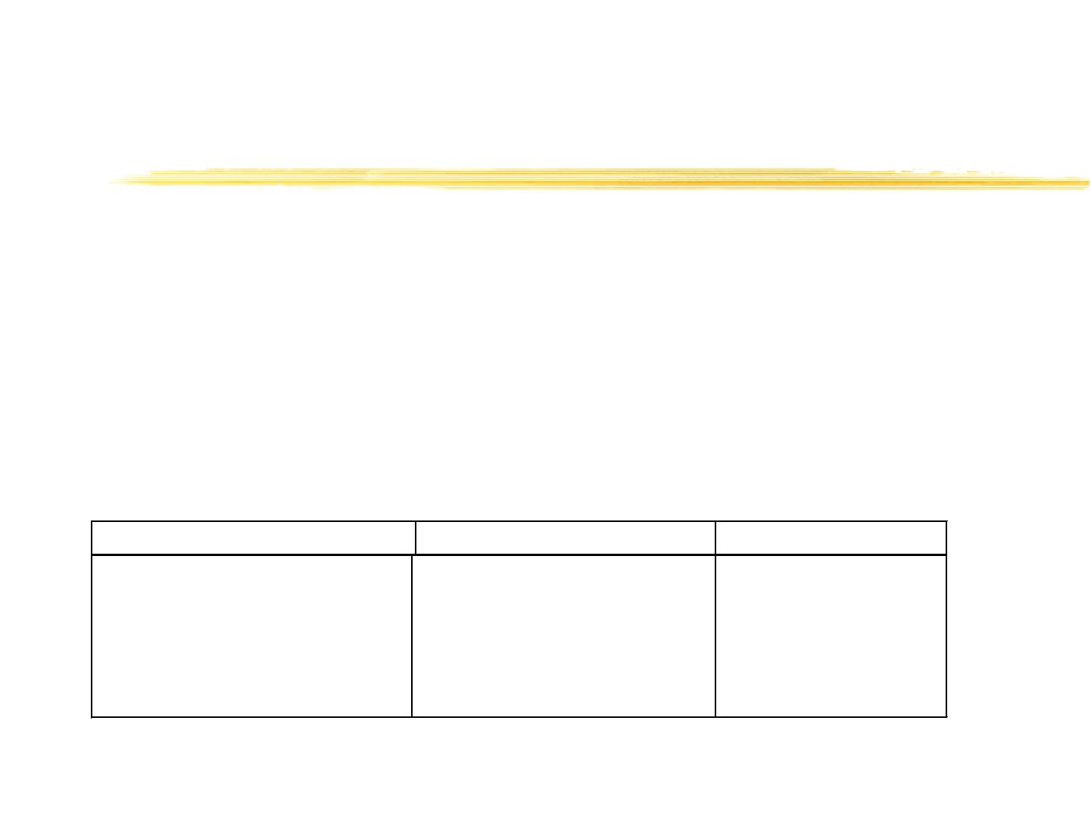
Example of UAN specification
Task: BuildRequest:
((SelR | ClearR | IconifyR)*
--> SpecField+)
Task: SelApplication
User Action
Interface Feedback
Interface State
~[x,y in AppICON]
∨∧(t<tdoubleClick) ∨∧
w’!: w’-!
UnMap(PrevAppliMenu)
Map(AppMenu)
UnMap(AppICON)
CurAppli=App
CurMenu=AppMenu
Tools and Methods based on Task Models

Slide 43

Domain model
Definition
A domain model defines the objects that a
user can view, access, and manipulate
through a user interface
A domain model represents objects of the
domain with their relationships
Historically, data models have been
considered for a while, but they are only a
subset of domain models
Data
Model
Tools and Methods based on Task Models
Domain
Model

Slide 44
Domain Model
Domain models extend data models
Relationships among objects are made
explicit and declarative
Data models are useful only for automatic
layout generation
Domain models are can help to identify
effective layout and user interface behavior
Tools and Methods based on Task Models

Slide 45
ConcurTaskTrees
Focus on Activities
Hierarchical Structure
Graphical Syntax
Rich set of temporal operators
Task allocation
Objects and task attributes
Tools and Methods based on Task Models

Slide 46
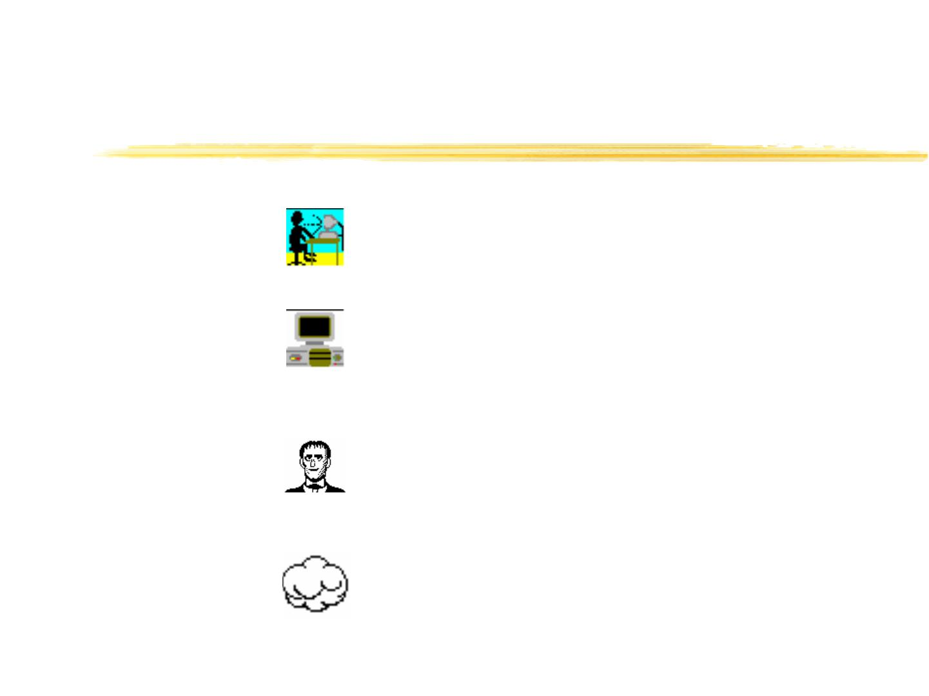
Categories of tasks
interaction
application
user
abstract
Tools and Methods based on Task Models

Slide 47

Temporal operators
Enabling
T1 >> T2 or T1 [ ]>> T2
Disabling
Interruption
Choice
T1 [> T2
T1 |> T2
T1 [ ] T2
Iteration
T1* or T1{n}
T1 ||| T2 T1 |[]| T2
[T]
Concurrency
Optionality
Order Independency T1 |=| T2
Tools and Methods based on Task Models

Slide 48
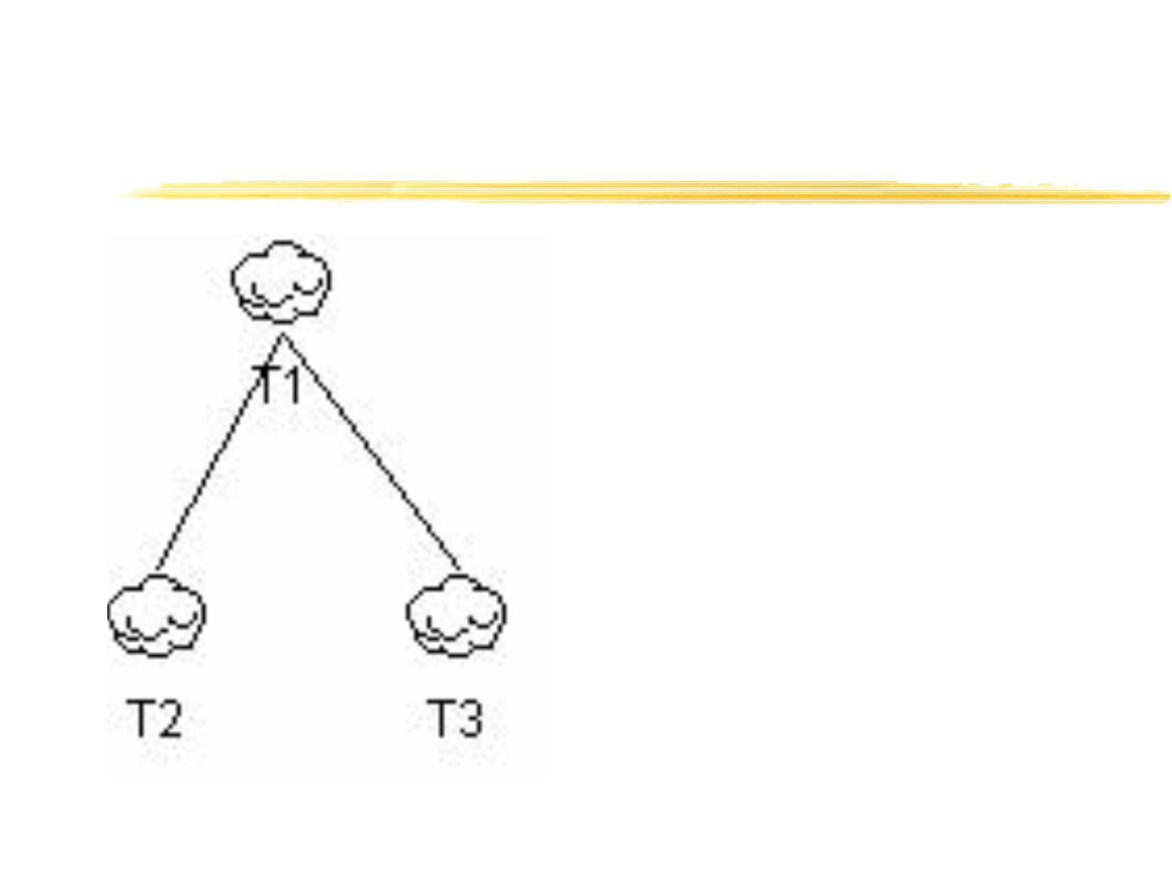
Hierarchy
 Tasks at same level represent
different options or different
tasks that have to be
performed
 Read levels as “In order to do
T1, I need to do T2 and T3”,
or “In order to do T1, I need
to do T2 or T3”
Tools and Methods based on Task Models

Slide 49
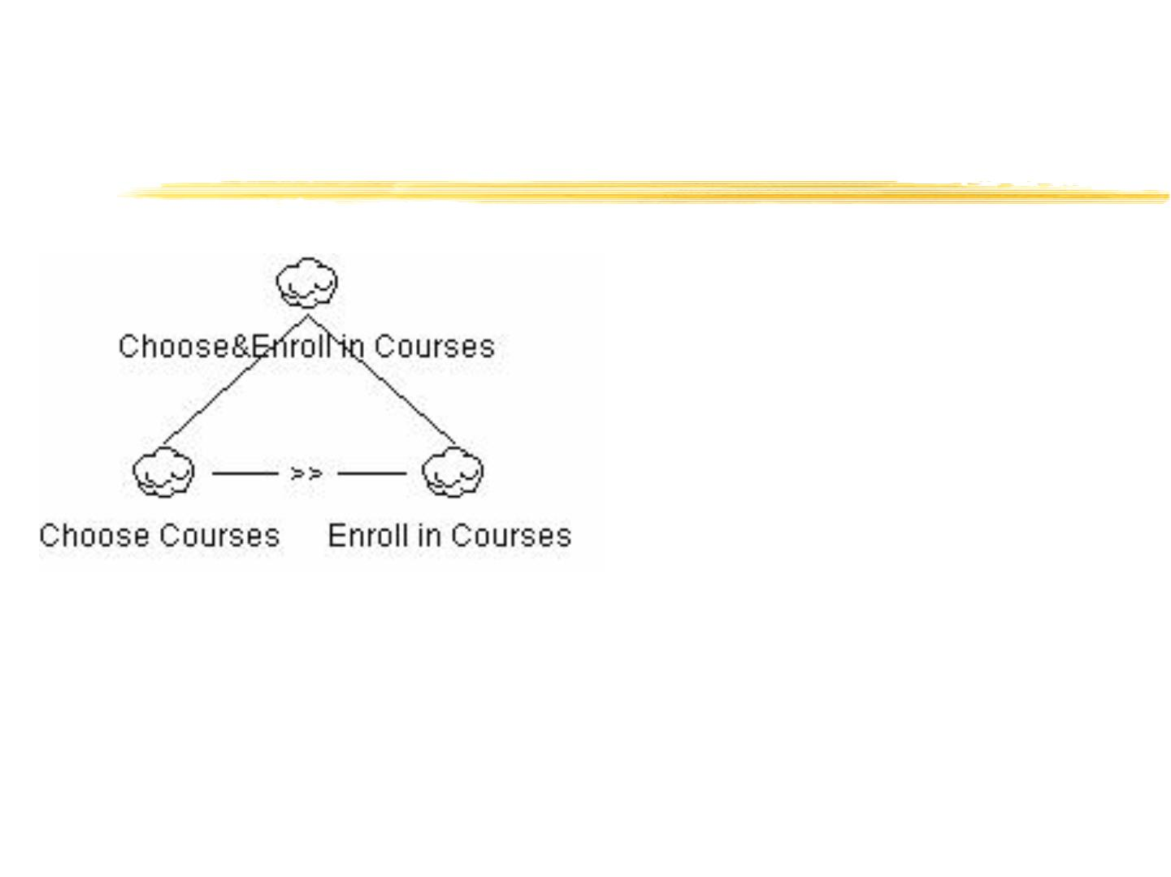
Enabling
 Specifies second task cannot
begin until first task performed
 I.e., I cannot enroll at
university before I’ve chosen
which courses to take
Tools and Methods based on Task Models

Slide 50
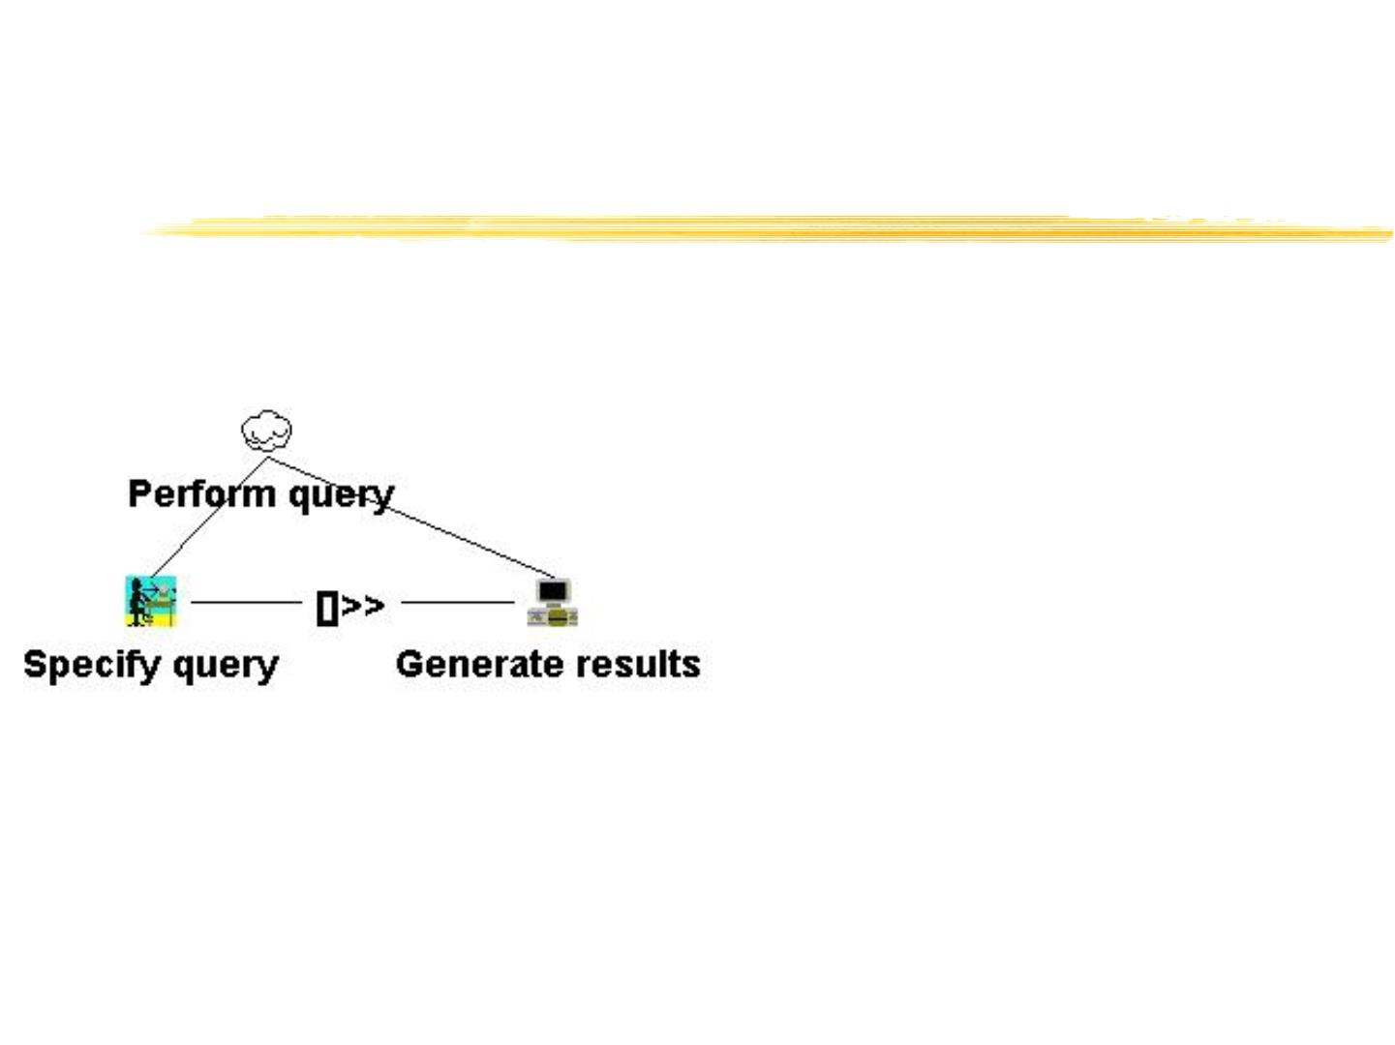
Enabling with Information
Flow
 Specifies second task cannot
be performed until first task is
performed, and that
information produced in first
task is used in second
Tools and Methods based on Task Models

Slide 51
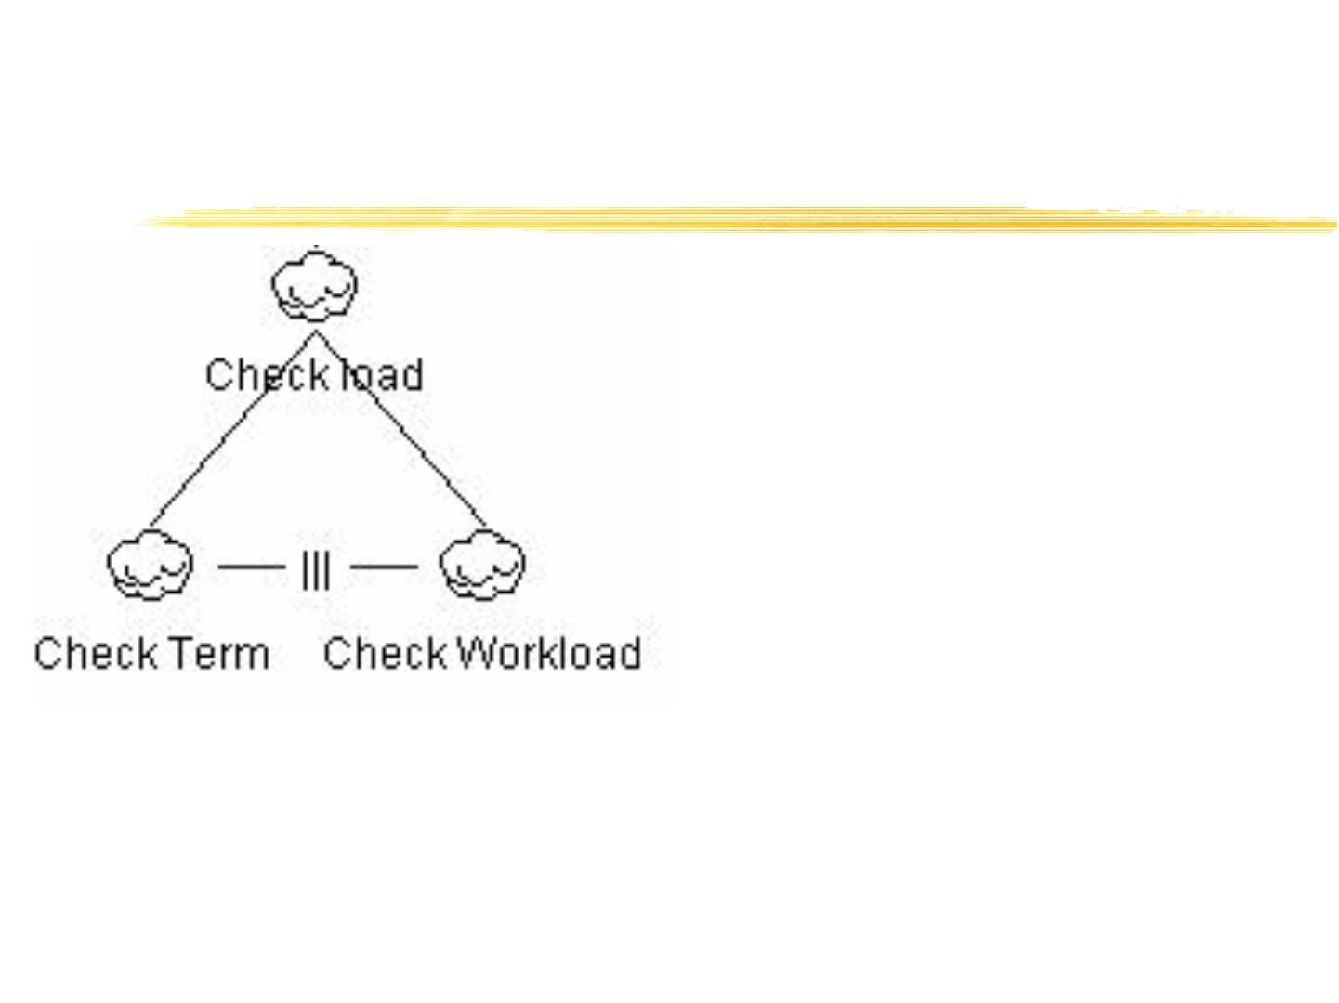
Interleaving
 Tasks can be performed in any
order, or at same time
 In order to check the load of a
set of courses, I need to
consider what terms they fall
in and to consider how much
work each course represents
 I can do this in any order
Tools and Methods based on Task Models

Slide 52
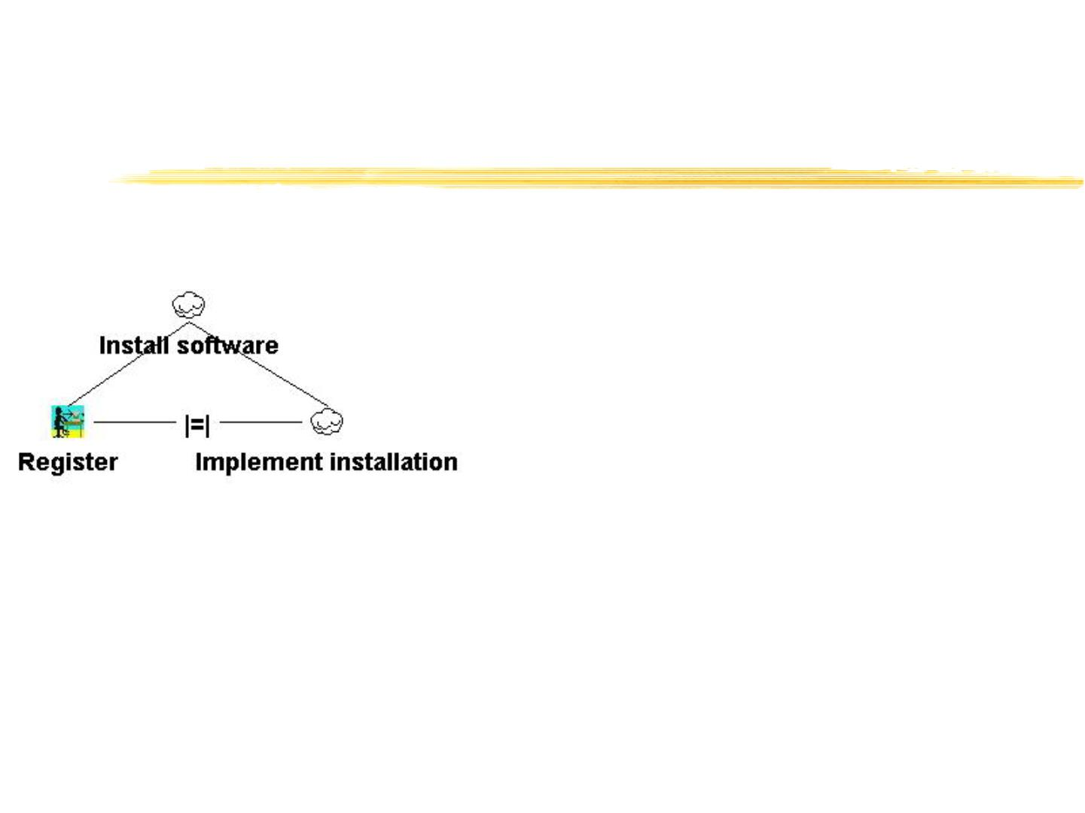
Order Independence
 Tasks can be performed in any
order, but when one starts
then it has to finish before the
other one can start
 When I install new software I
can start by either registering
or implementing the
installation but if I start one
task I have to finish it before
moving to the other one
Tools and Methods based on Task Models

Slide 53
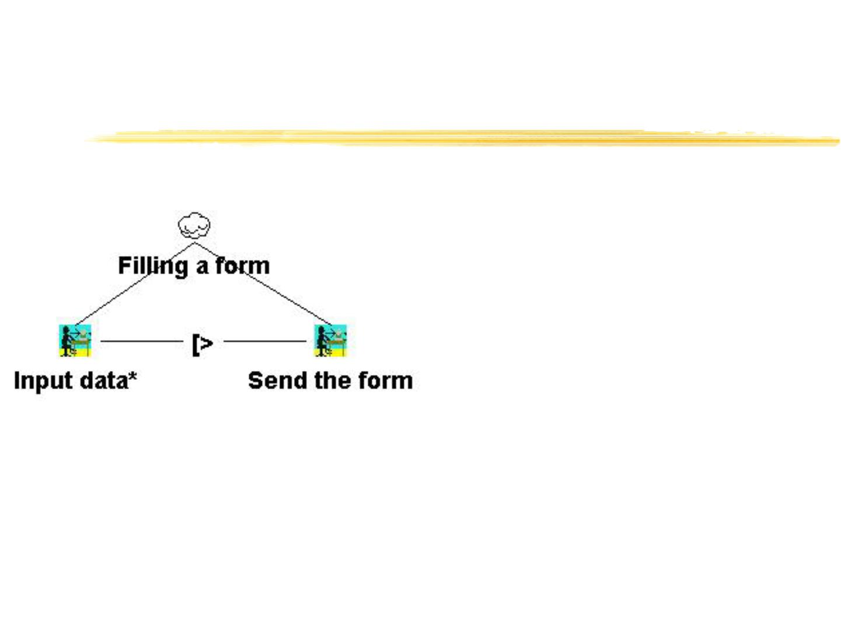
Disabling
 The first task (usually
an iterative task) is
completely
interrupted by the
second task
Tools and Methods based on Task Models

Slide 54
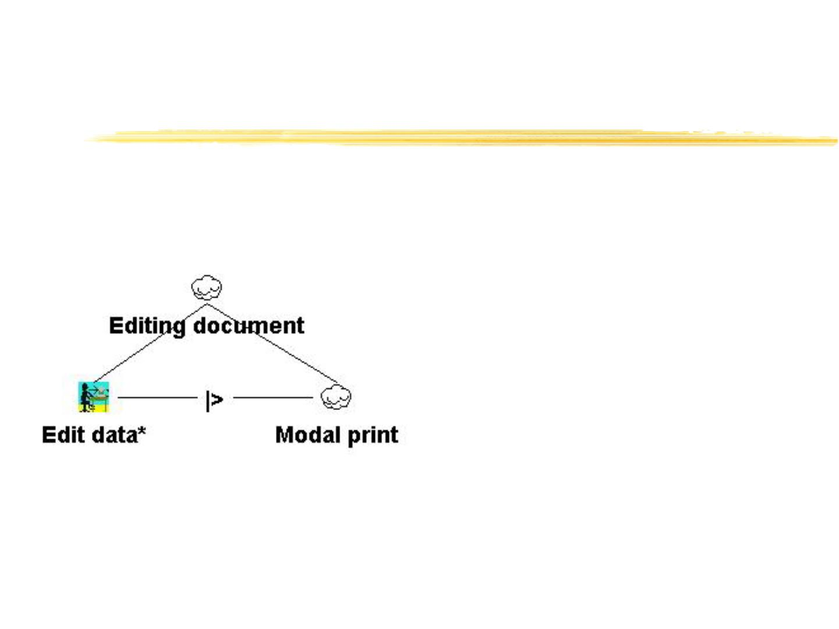
Suspend-resume
First task can be
interrupted by the
second one
When the second
terminates then the
first one can be
reactivated from the
state reached before
Tools and Methods based on Task Models

Slide 55
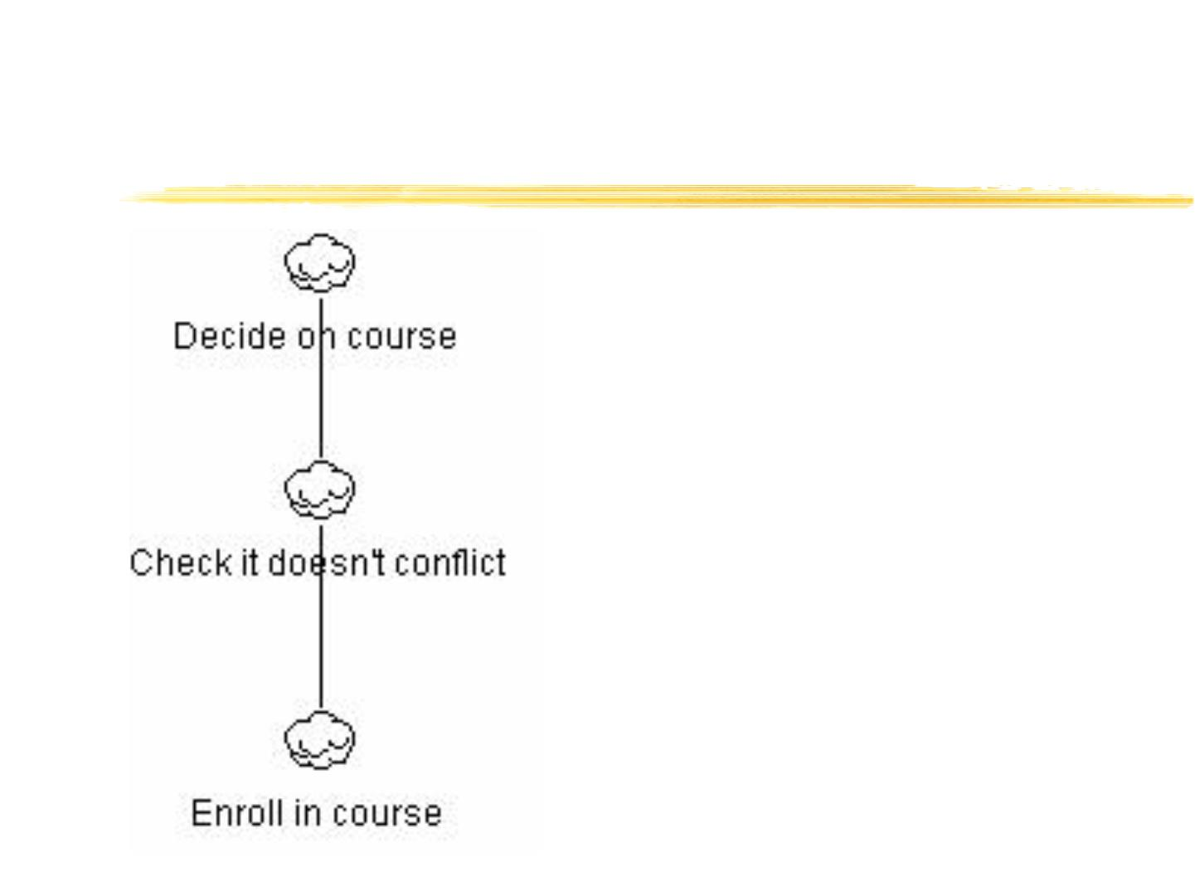
Common Errors
Hierarchy does NOT
represent sequence
“In order to check a
course doesn’t
conflict, I have to
enroll in the course”
Tools and Methods based on Task Models

Slide 56
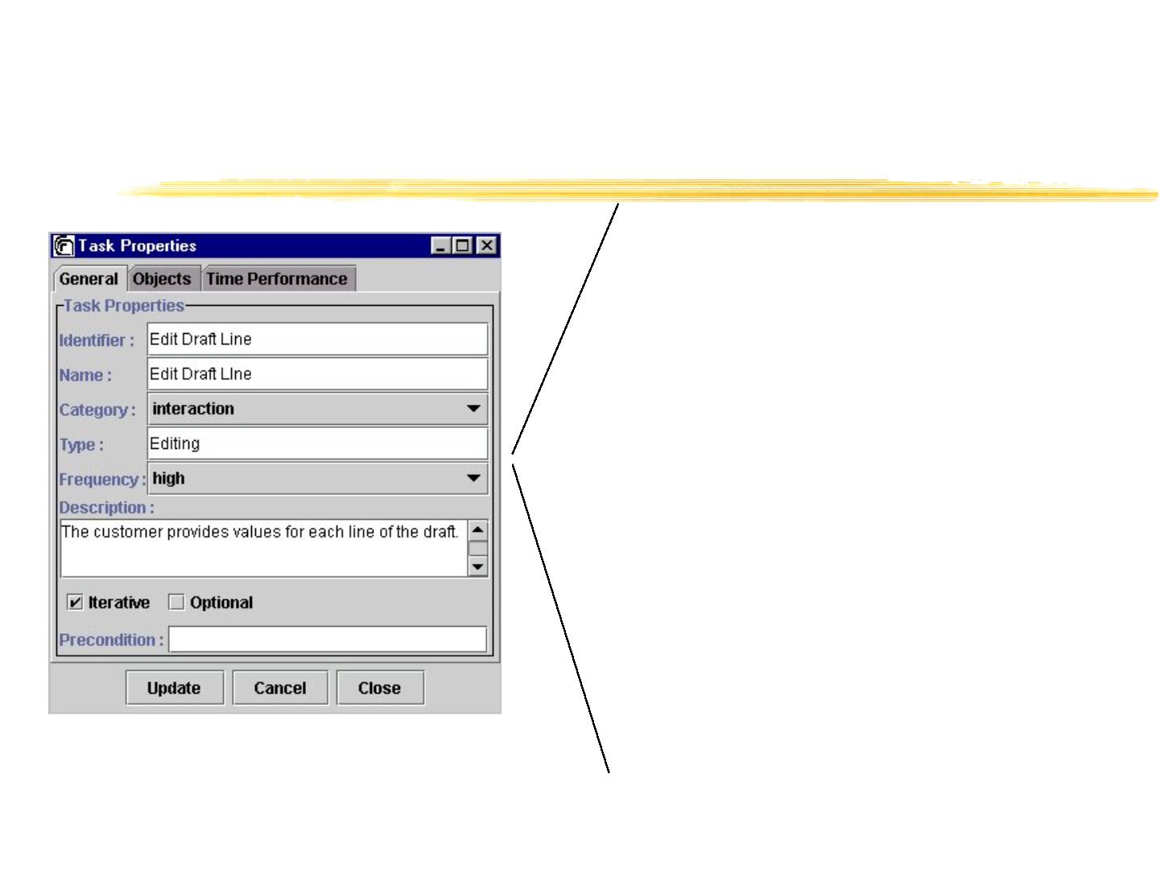
Task and attributes
Interaction tasks
Selection
Edit
Control
…
Application task
Overview
Feedback
Generating alerts
Grouping
...
Tools and Methods based on Task Models

Slide 57
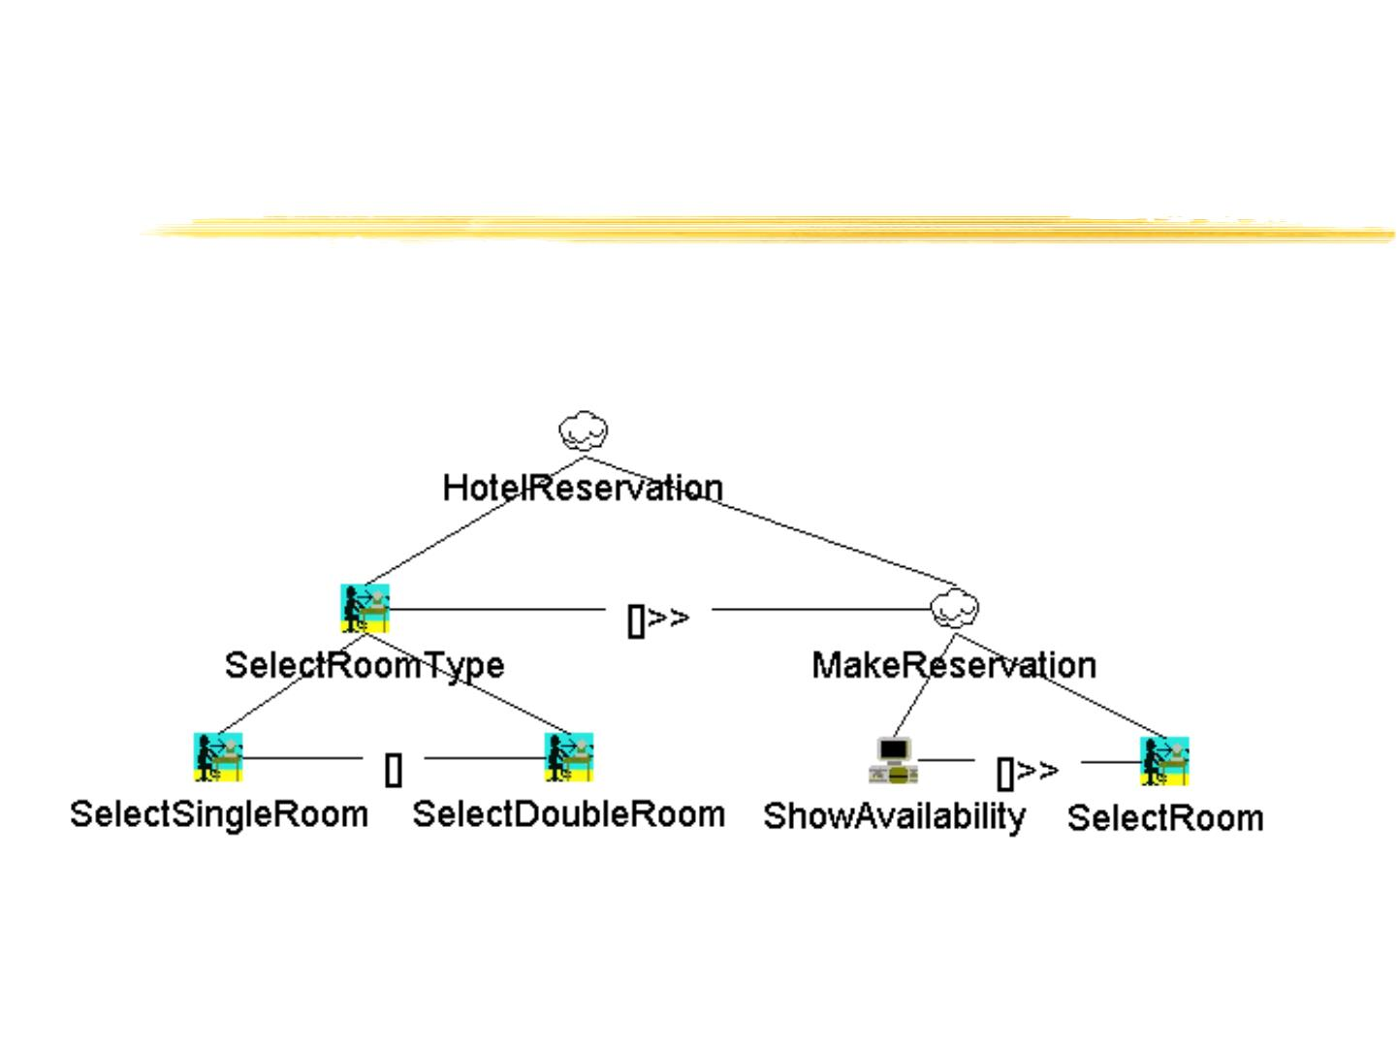
Inheritance of relationships
Tools and Methods based on Task Models

Slide 58
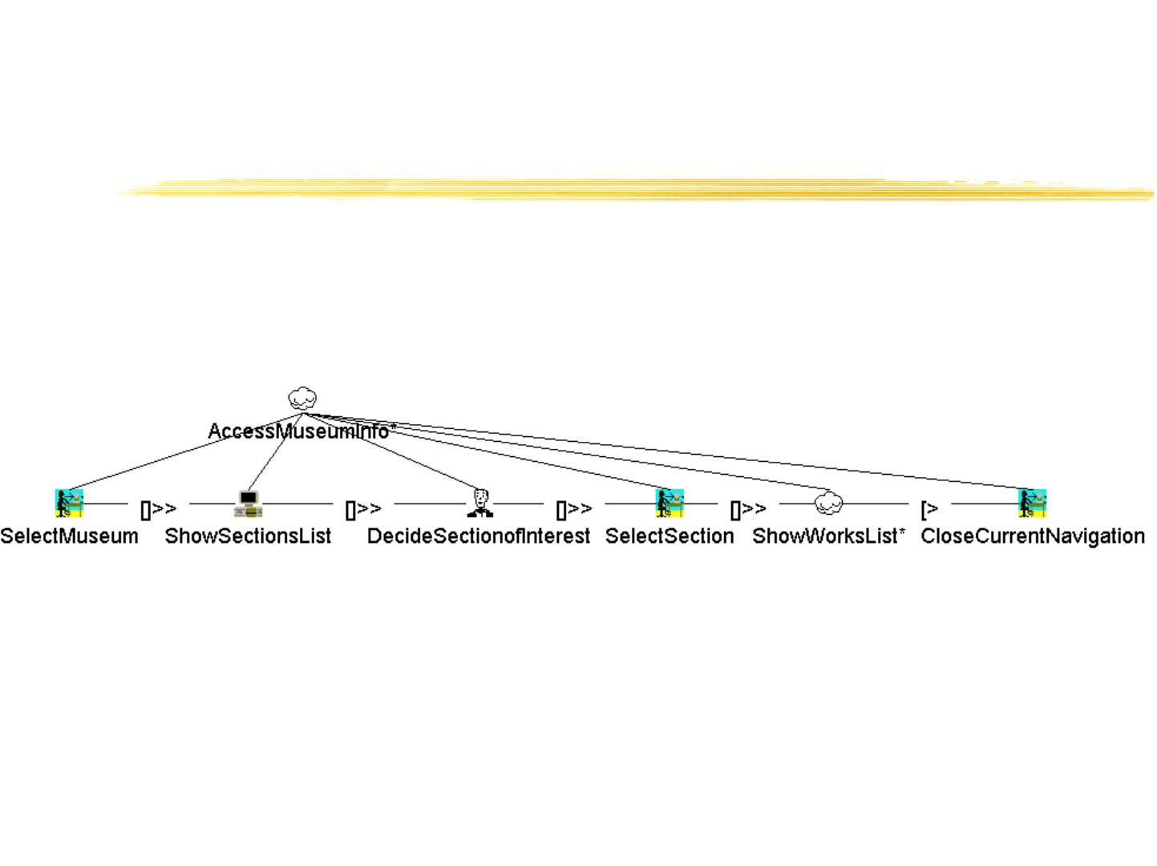
Relationships task/subtasks
Tools and Methods based on Task Models

Slide 59
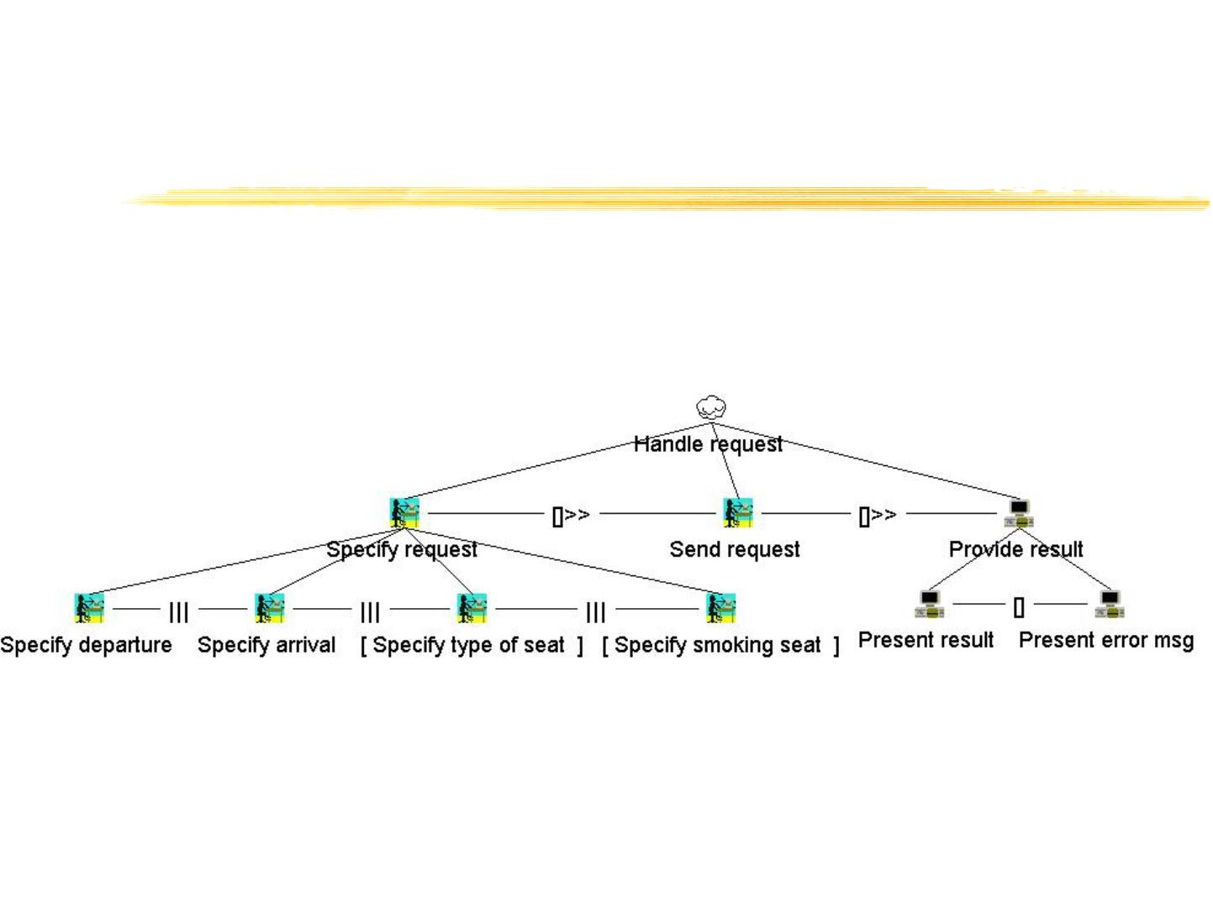
Optional tasks
Tools and Methods based on Task Models

Slide 60
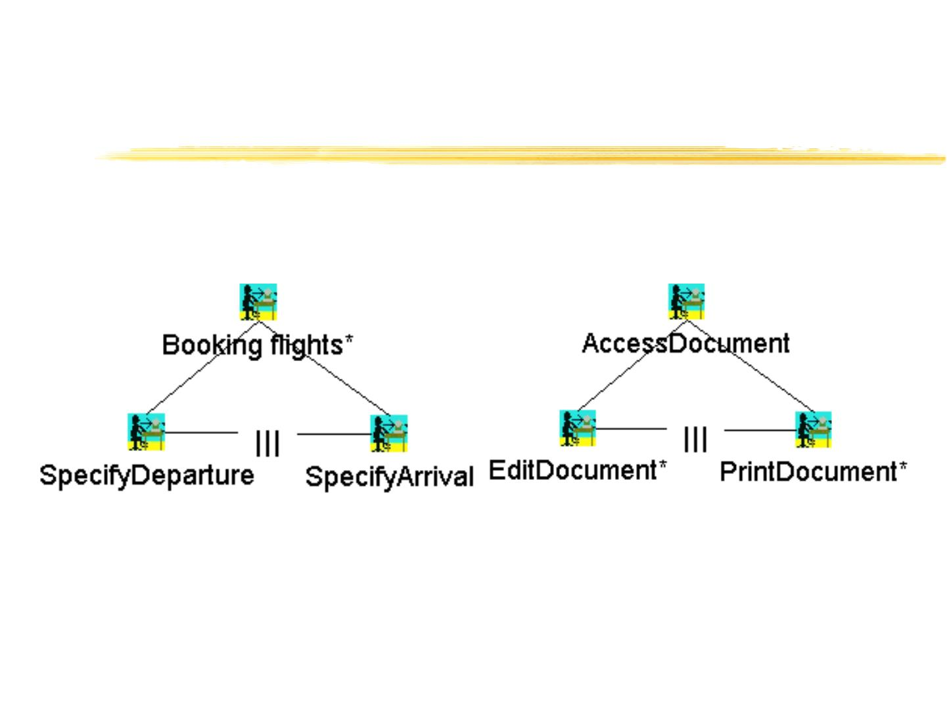
Multiple performance /
continuous interleaving
Tools and Methods based on Task Models

Slide 61
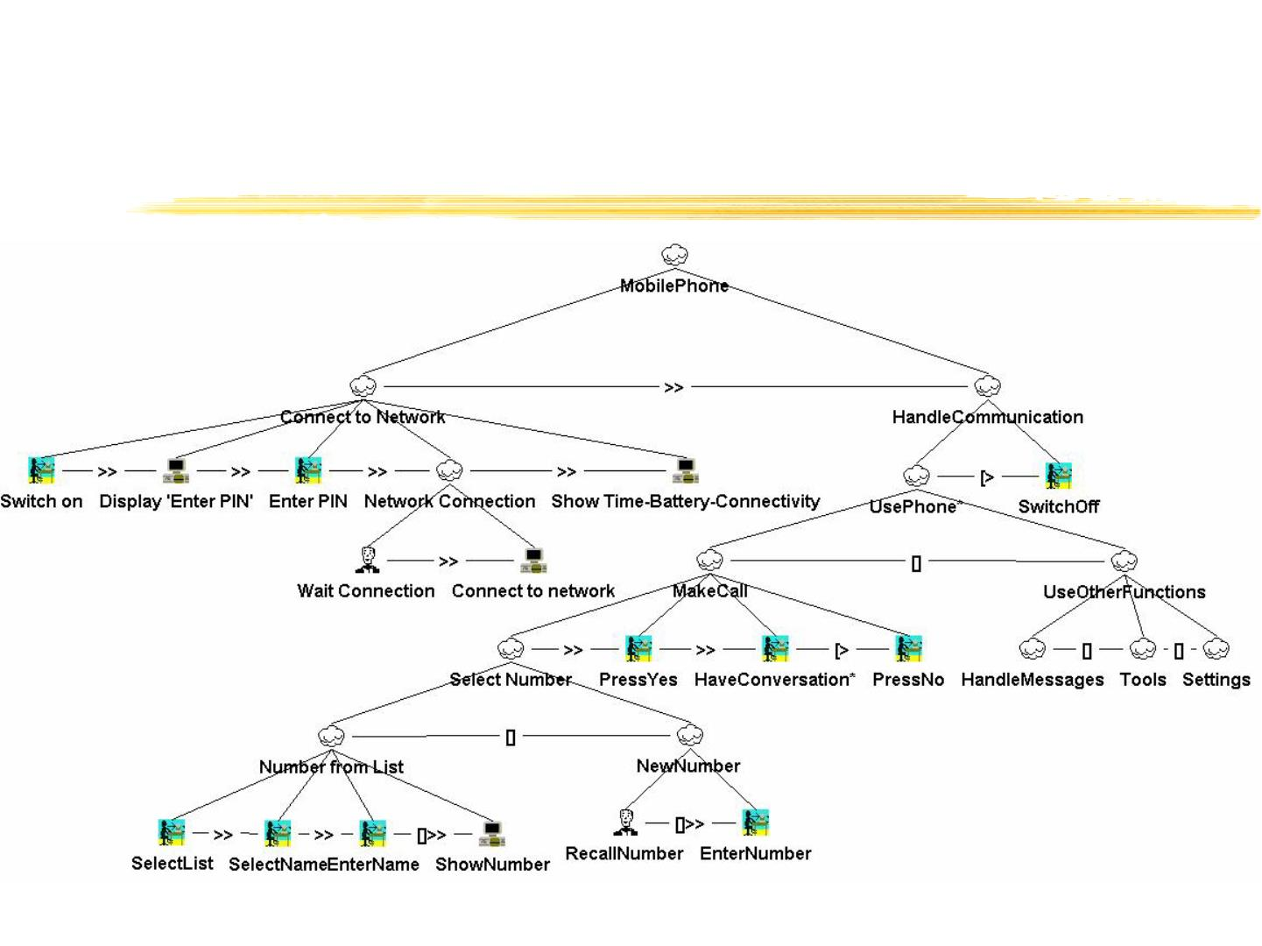
An Example
Tools and Methods based on Task Models

Slide 62

Representations of Task Models
GOMS
UAN
CTT
MAD
GTA
Sequence
X
X
X
X
X
X
X
X
X
X
X
X
Order independence
Interruption
X
X
Concurrency
Only CPM-
GOMS
X
Optionality
Iteration
X
X
X
X
X
X
X
X
X
X
X
X
X
X
Allocation
Objects
Performance
Pre-post conditions
X
X
X
X
Tools and Methods based on Task Models

Slide 63
Tool support
GTA – Euterpe
VTMB -TAMOSA
ICO – PetShop
Teallach
QGOMS
Tools and Methods based on Task Models

